Slide 1
An introduction to requirements engineering
Nazim H. Madhavji
University of Western Ontario
Lecture based on the book by Kotonya & Sommerville
N.H. Madhavji

Slide 2
Requirements Engineering
An introduction to requirements engineering
Gerald Kotonya and Ian Sommerville
Chapter 1

Slide 3
Objectives
To introduce the notion of system requirements and the requirements engineering process.
To explain how requirements engineering fits into a broader system engineering process
To explain the importance of the requirements document

Slide 4
System requirements
Define what the system is required to do and the constraints under which it is required to operate
  The system shall maintain records of all library materials including books, serials, newspapers and magazines, video and audio tapes, reports, collections of transparencies, computer disks and CD-ROMs.
  The system shall allow users to search for an item by title, author, or by ISBN.
  The system’s user interface shall be implemented using a World-Wide-Web browser.
  The system shall support at least 20 transactions per second.
  The system facilities which are available to public users shall be demonstrable in 10 minutes or less.

Slide 5
What will be different in the Environment after system is put to use?
Think of what you want the system’s environment to be like after the new/enhanced system has been put into operation.
Use THIS information to derive your requirements.
© N.H. Madhavji

Slide 6
Types of requirements
Very general requirements which set out in broad terms what the system should do.
Functional requirements which define part of the system’s functionality.
Implementation requirements which state how the system must be implemented.
Performance requirements which specify a minimum acceptable performance for the system.
Usability requirements which specify the maximum acceptable time to demonstrate the use of the system.

Slide 7
Types of requirements
In addition, there are other types of requirements that you may already know of or may have experienced:
Security
Safety
Availability
Error recovery and handling
Monitoring of System Performance and Resource Utilisation
Compliance
Etc.
© N.H. Madhavji

Slide 8
Conceptual thinking on requirements
It is important to note that requirements are “not” always given to the system planners on a “silver platter”. They have to be elicited from numerous sources. Example sources?
Stakeholder needs (customers, end-users, market research, competition, etc.)
Business ideas and strategies
Immediate environment (e.g., development standards, inter-operability, etc.)
System defects and failures (problem reports)
Government and other policies and laws, etc.
© N.H. Madhavji

Slide 9
Conceptual thinking on requirements
Thus, novelty or innovation in software systems or products is a lot based on creative thinking during system requirements engineering.
So, don’t do a sloppy job of the requirements work and get into nitty-gritty of system design and implementation and testing! This is simply stupid.
  Imagine you were doing a house building project or designing new models of your current automobile line of products.
  Doing things as an afterthought may not work from the business point of view and can be very expensive!
© N.H. Madhavji

Slide 10
Conceptual thinking on requirements
Of course, system development is not always from scratch. After initial development, the system enters a long evolutionary stage before it is made to retire.
Thus, generally, requirements work must consider enhancement of the existing system.
  What to enhance? How much is enough?
    What is the structure & dynamics of the existing system?
    How to integrate the new requirements with the old ones?
  Meeting cost and cycle-time constraints, in addition to the quality constraints.
  There is a whole discipline to this, called “Software Evolution”.
© N.H. Madhavji

Slide 11
Requirements problems
The requirements don’t reflect the real needs of the customer for the system.
Requirements are inconsistent and/or incomplete.
It is expensive to make changes to requirements after they have been agreed.
There are misunderstandings between customers, those developing the system requirements and software engineers developing or maintaining the system.

Slide 12
FAQS about requirements
What are requirements?
  A statement of a system service or constraint
What is requirements engineering?
  The processes involved in developing system requirements
How much does requirements engineering cost?
  About 15% of system development costs
What is a requirements engineering process?
  The structured set of activities involved in developing system requirements

Slide 13
FAQs contd.
What happens when the requirements are wrong?
  Systems are late, unreliable and don’t meet customers needs
Is there an ideal requirements engineering process?
  No - processes must be tailored to organisational needs
What is a requirements document?
  The formal statement of the system requirements
What are system stakeholders?
  Anyone affected in some way by the system

Slide 14
FAQs contd.
What is the relationship between requirements and design?
  Requirements and design are interleaved. They should, ideally, be separate processes but in practice this is impossible
What is requirements management?
  The processes involved in managing changes to requirements

Slide 15
Systems engineering
There is a close relationship between software and more general system requirements
  NHM:
    “software requirements” deal with the “software” side of a system.
    “system requirements” deal with the “hardware” that embodies the software.
    Thus, for hardware-software systems it is important to ensure the compatibility of both types of requirements.
      Not only at the start of the project but throughout the life of the “system” as a whole.

Slide 16
Systems engineering
Computer-based systems fall into two broad categories:
  User-configured systems where a purchaser puts together a system from existing software products
  Custom systems where a customer produces a set of requirements for hardware/software system and a contractor develops and delivers that system

Slide 17
Classes of custom systems
Information systems
  Primarily concerned with processing information which is held in some database.
Embedded systems
  Systems where software is used as a controller in some broader hardware system
Command and control systems
  Essentially, a combination of information systems and embedded systems where special purpose computers provide information which is collected and stored and used to make decisions

Slide 18
Emergent properties
Emergent properties are properties of the system as a whole and only emerge once all of its individual sub-systems have been integrated
Examples of emergent properties
  Reliability
  Maintainability
  Performance
  Usability
  Security
  Safety

Slide 19
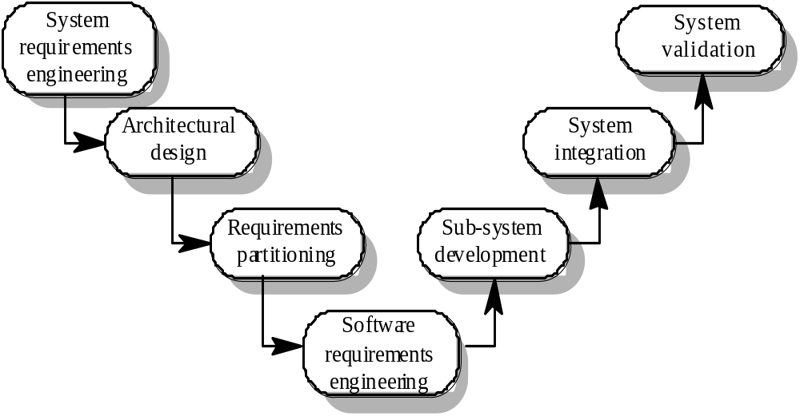
The systems engineering process

Slide 20
System engineering activities
System requirements engineering
  The requirements for the system as a whole are established and written to be understandable to all stakeholders
Architectural design
  The system is decomposed into sub-systems
Requirements partitioning
  Requirements are allocated to these sub-systems
Software requirements engineering
  More detailed system requirements are derived for the system software

Slide 21
System engineering activities
Sub-system development
  The hardware and software sub-systems are designed and implemented in parallel.
System integration
  The hardware and software sub-systems are put together to make up the system.
System validation
  The system is validated against its requirements.

Slide 22
Requirements document
The requirements document is a formal document used to communicate the requirements to customers, engineers and managers.
The requirements document describes:
  The services and functions which the system should provide
  The constraints under which the system must operate
  Overall properties of the system i.e.. constraints on the system’s emergent properties
  Definitions of other systems which the system must integrate with.

Slide 23
Requirements document
The requirements document describes:
  Information about the application domain of the system e.g. how to carry out particular types of computation
  Constraints on the processes used to develop the system
  Description of the hardware on which the system is to run
In addition, the requirements document should always include an introductory chapter which provides an overview of the system, business needs supported by the system and a glossary which explains the terminology used.

Slide 24
Users of requirements documents
System customers
  specify the requirements and read them to check they meet their needs
Project managers
  Use the requirements document to plan a bid for system and to plan the system development process
System engineers
  Use the requirements to understand the system being developed
System test engineers
  Use the requirements to develop validation tests for the system
System maintenance engineers
  Use the requirements to help understand the system

Slide 25
Requirements document structure
IEEE/ANSI 830-1993 standard proposes a structure for software requirements documents
Introduction
  1.1 Purpose of requirements document
  1.2 Scope of the product
  1.3 Definitions, acronyms and abbreviations
  1.4 References
  1.5 Overview of the remainder of the document

Slide 26
Requirements document structure
2. General description
  2.1 Product perspective
  2.2 Product functions
  2.3 User characteristics
  2.4 General constraints
  2.5 Assumptions and dependencies
3. Specific requirements
  Covering functional, non-functional and interface requirements.
4. Appendices
Index

Slide 27
Adapting the standard
The IEEE standard is a generic standard which is intended apply to a wide range of requirements documents.
In general, not all parts of the standard are required for all requirements documents
Each organisation should adapt the standard depending on the type of systems it develops
Consider a company (XYZ) that develops scientific instruments

Slide 28
Organisation XYZ standard
Preface
  This should define the expected readership of the document and describe its version history including a rationale for the creation of a new version and a summary of the changes made in each version.
Introduction
  This should define the product in which the software is embedded, its expected usage and present and overview of the functionality of the control software.
Glossary
  This should define all technical terms and abbreviations used in the document.

Slide 29
Organisation XYZ standard
General user requirements
  This should define the system requirements from the perspective of the user of the system. These should be presented using a mixture of natural language and diagrams.
System architecture
  This chapter should present a high-level overview of the anticipated system architecture showing the distribution of functions across system modules. Architectural components which are to be reused should be highlighted.
Hardware specification
  This is an optional chapter specifying the hardware that the software is expected to control. It may be omitted if the standard instrument platform is used.

Slide 30
Organisation XYZ standard
Detailed software specification
  This is a detailed description of the functionality expected of the software of the system. It may include details of specific algorithms which should be used for computation. If a prototyping approach is to be used for development on the standard instrument platform, this chapter may be omitted.
Reliability and performance requirements
  This chapter should describe the reliability and performance requirements which are expected of the system. These should be related to the statement of user requirements in Chapter 4.
NHM: Don’t forget safety, security, availability, etc., requirements.

Slide 31
Organisation XYZ standard
The following appendices may be included where appropriate:
  Hardware interface specification
  Software components which must be reused in the system implementation
  Data structure specification
  Data-flow models of the software system
  Detailed object models of the software system
Index

Slide 32
Writing requirements
Requirements are usually written as paragraphs of natural language text supplemented by diagrams and equations
Problems with requirements
  use of complex conditional clauses which are confusing
  sloppy and inconsistent terminology
  writers assume readers have domain knowledge

Slide 33
Writing essentials
Requirements are read more often than they are written. You should invest time to write readable and understandable requirements
Do not assume that all readers of the requirements have the same background and use the same terminology as you
Allow time for review, revision and re-drafting of the requirements document

Slide 34
Writing guidelines
Define standard templates for describing requirements
Use language simply consistently and concisely
Use diagrams appropriately
Supplement natural language with other description of requirements
Specify requirements quantitatively

Slide 35
Key points
Requirements define what the system should provide and define system constraints
Requirements problems lead to late delivery and change requests after the system is in use
Requirements engineering is concerned with eliciting, analysing, and documenting the system requirements

Slide 36
Key points
Systems engineering is concerned with systems as a whole including hardware, software and operational processes
The requirements document is the definitive specification of requirements for customers, engineers and managers.
The requirements document should include a system overview, glossary, statement of the functional requirements and the operational constraints

Slide 37
Ze End.
© N.H. Madhavji

